Slide 1
HUMAN FREEDOM INDEX
Group - 4
Team Members
ASEER JESAN.A
BALAKUMAR.S
HARIHARAN.M
MOHAN PRABHU.E
Guided by
Ms.Anjana Agrawal

Slide 2
INTRODUCTION
Problem Statement
Primary Goal: Predicting Human freedom score based on Personal Freedom score and Economic freedom score for all countries.
Secondary Goal: To analyse India’s position for consecutive years from 2008 - 2016 and suggest which attributes to focus on to improve its position for upcoming years.
DESCRIPTION
Human Freedom Index presents the state of human freedom in the world based on a broad measure that encompasses personal, civil, and economic freedom. HFI presents a broad measure of human freedom, understood as the absence of coercive constraint and uses 79 distinct indicators of personal and economic freedom. The following areas as follows:
Rule of Law, Security and Safety, Movement, Religion, Association, Assembly, Civil Society, Expression, Relationships, Size of Government, Legal System and Property Rights, Access to Sound Money, Freedom to Trade Internationally, and Regulation of Credit, Labour and Businesses

Slide 3
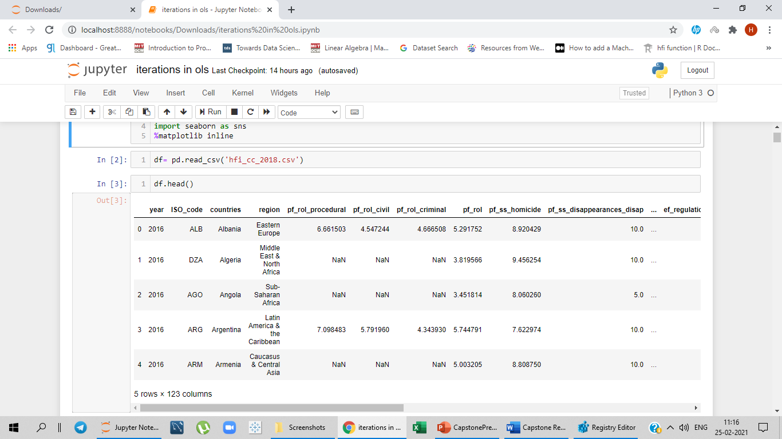
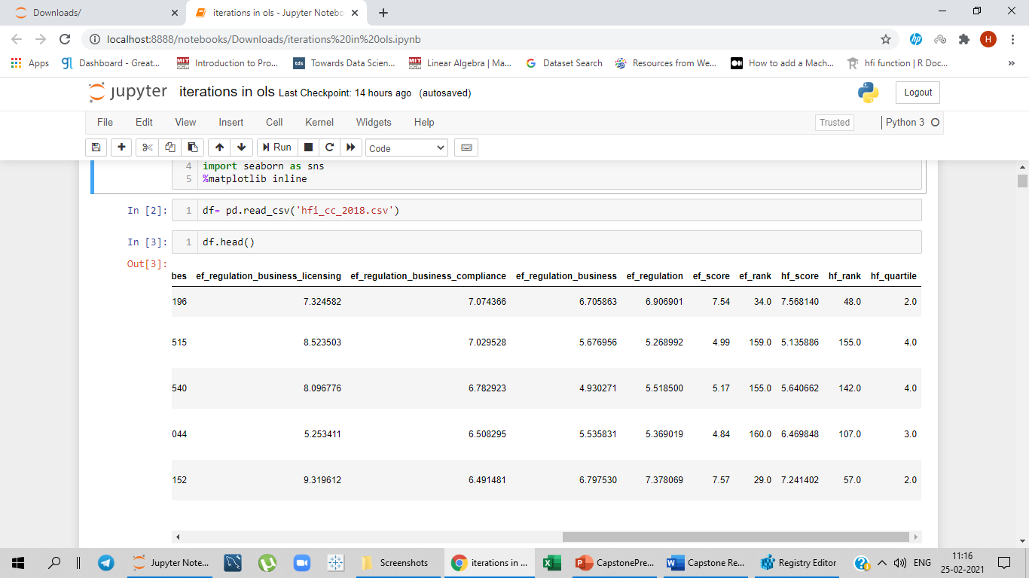
DATASET
The dataset contains 1458 observations and 123 variables.
The following columns in the dataset explains.
pf_score - Personal Freedom score which says about other 57 pf columns.
ef_score - Economic freedom score which says about other 55 ef columns
Based on pf_score and ef_score averages, hf_score- Human freedom score is calculated.
Based on hf_score, hf_rank - Human freedom rank and hf_quartile - Human freedom quartile is calculated.
Fig.(i)
Fig.(i). shows the dataset

Slide 4
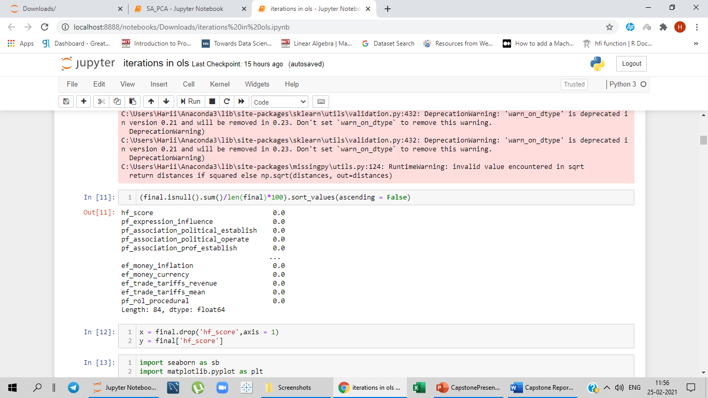
PREPROCESSING THE DATA
Complexity involved:
Since the data has 123 columns, the complexity was
Finding relationship between the variables.
Eliminating multicollinear features.
Cleaning the data:
Treated null values using KNN imputer
Dropped the average columns in the dataset and performing null value imputations for columns having less than 80% and the features reduced to 84 columns.
Fig.(ii)
Fig.(ii) shows null value treatment

Slide 5
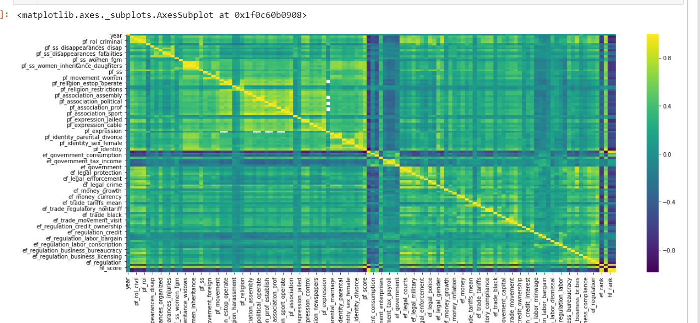
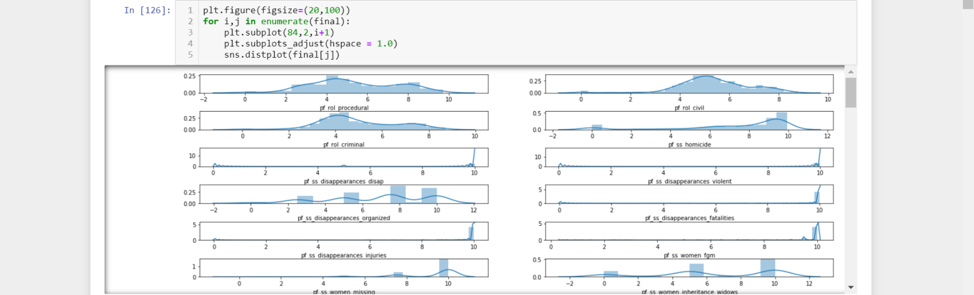
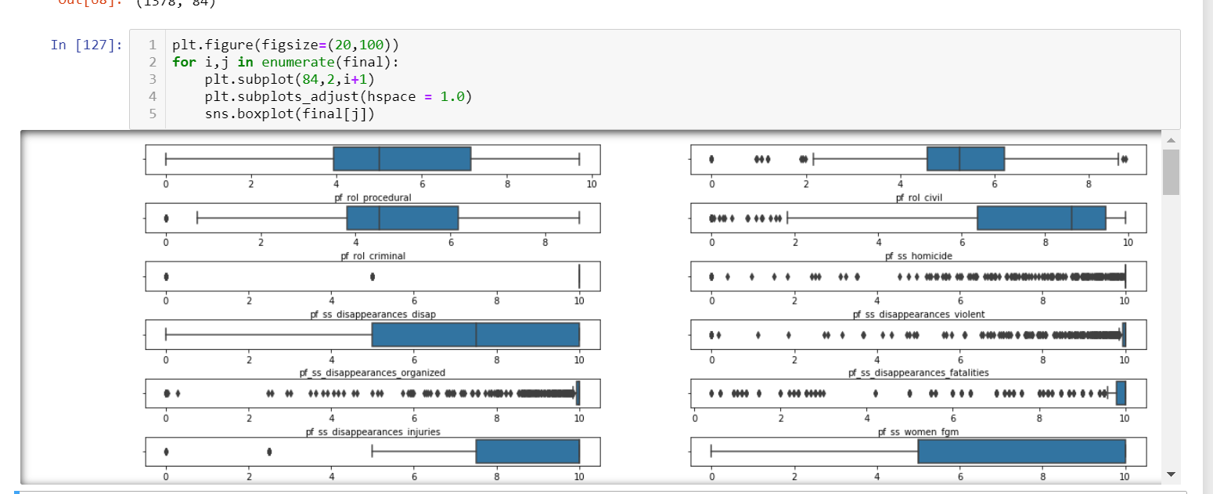
PREPROCESSING THE DATA
Fig.(iii)
Fig.(iv)
Fig.(iii) Correlation matrix for the dataset after null value treatment.
Fig.(iv) Some variables in the dataset are skewed
Fig.(v) Outliers are present
in the data
Fig.(v)

Slide 6
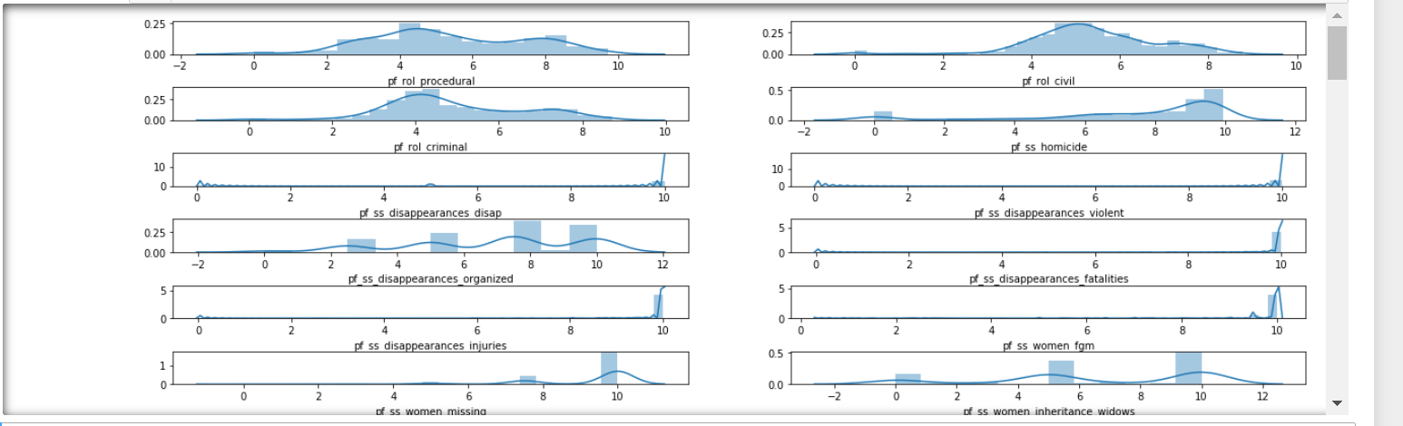
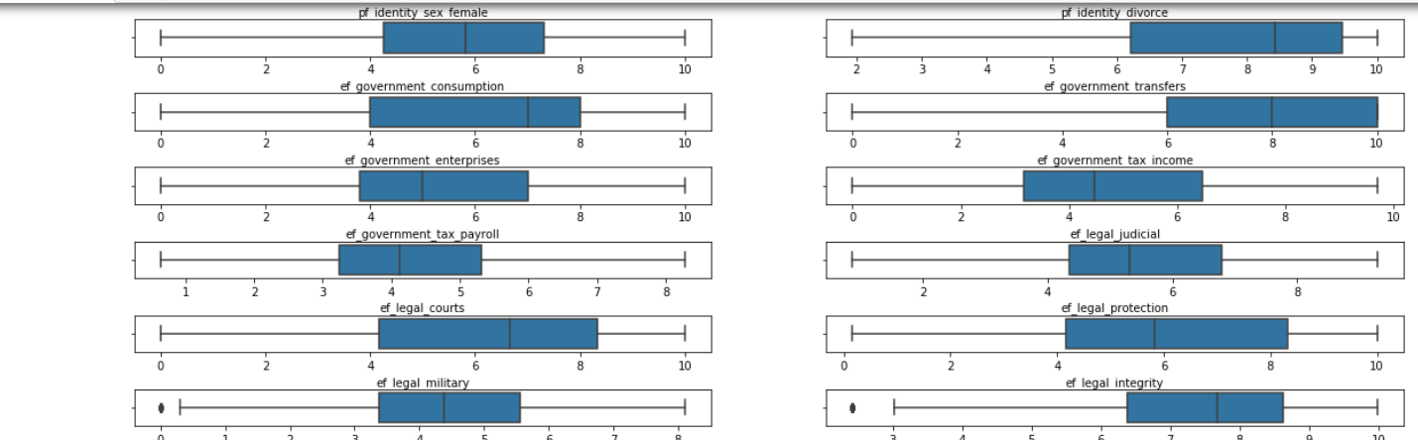
FEATURE ENGINEERING
There are some extreme values present in the data when compared to other normal values present in the data. In feature engineering segment using winsorization (Outlier Capping) to get rid of outliers.
Fig.(vi)
Fig.(vii)
Fig.(vi) Treating skewness through power transformer
Fig.(vii) Power Transform had no effect on outlier treatment. So, to eliminate outliers using winsorization.

Slide 7
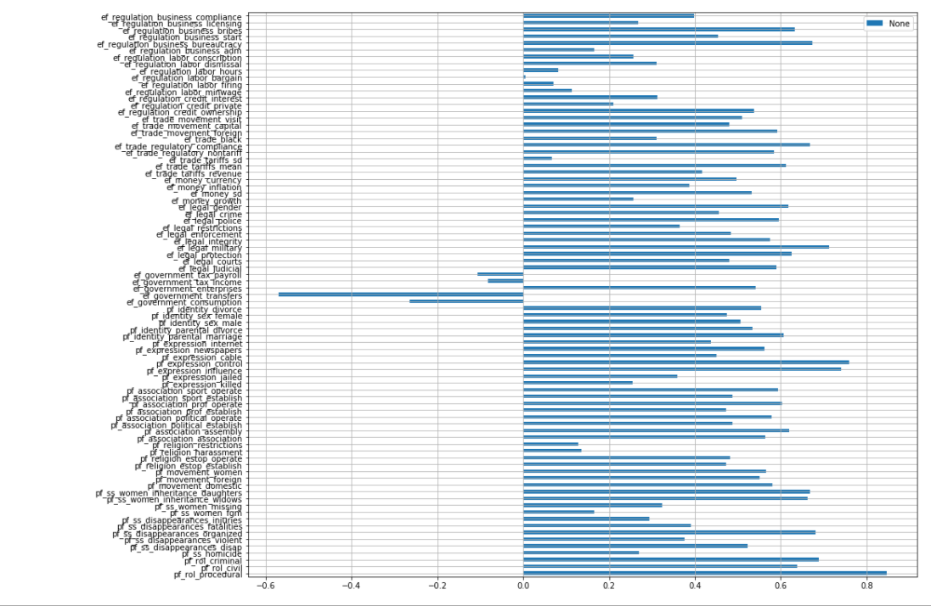
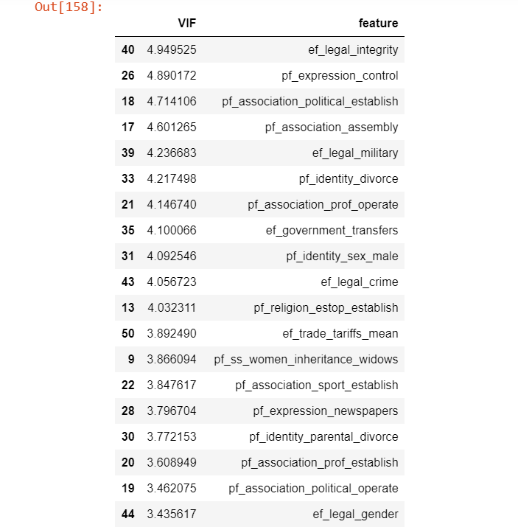
FEATURE ENGINEERING
Fig.(viii) How much each variable is correlated with the target variable.
All variable values are between -1 to 1
Fig.(viii)
MODEL PARAMETERS
Fitting the 72 feature columns in OLS and evaluating the model through OLS model by checking varying parameters and checking R-square and RMSE values.
1. Multicollinearity:
Fig.(ix) After eliminating multicollinear columns through VIF the features are reduced to 72 columns
Fig.(ix)

Slide 8
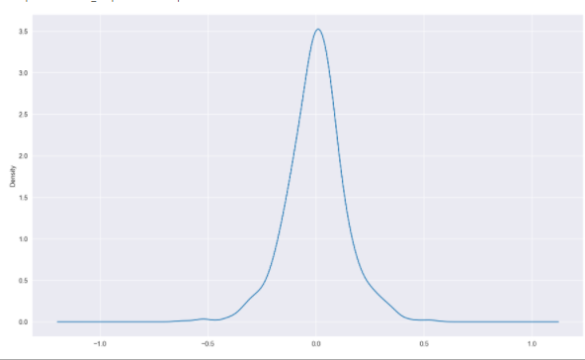
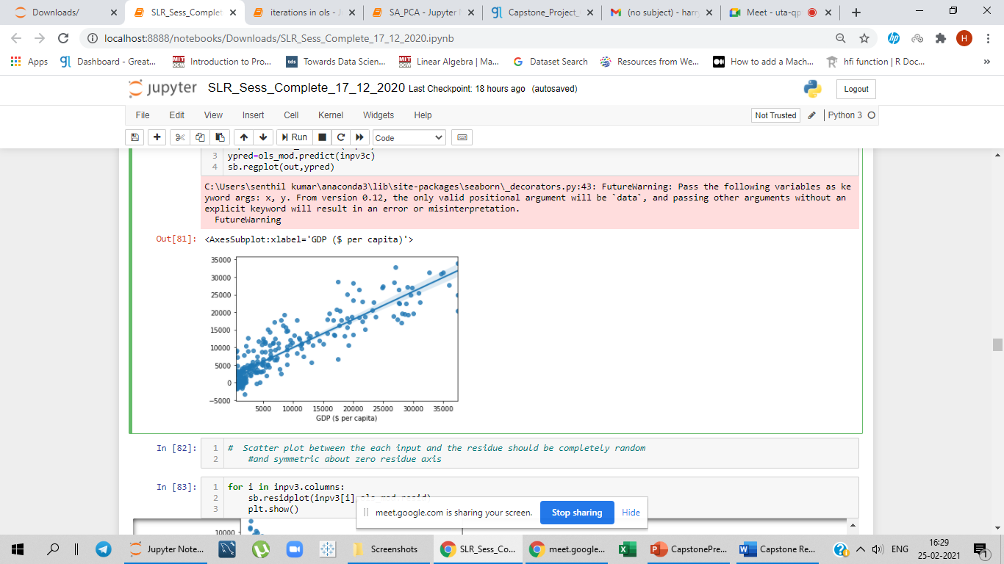
MODEL PARAMETERS
2. Normality :
The value for normality is -0.16
3. Linearity:
For Statistical test of Linear Rainbow
the p- value obtained is 0.89.
4. Auto Correlation :
Checked with respect to Durbin Watson value. Accepted range is between -1.5 to +2.5. The value obtained is 1.8.
5. Homoscedasticity:
Two Statistical tests are done to verify homoscedasticity
i.e., Goldfeld Quandt test or Breusch-Pagen test. For Goldfeld Quandt test, Null hypothesis: The model is Homoscedastic The value obtained is 0.99. Hence rejecting Null hypothesis shows the model is Homoscedastic.
Fig.(x) The resid plot shows the data is Normal.
Fig.(x)
Fig.(xi) The scatterplot shows randomness with zero residue axis.
Fig.(xi)

Slide 9
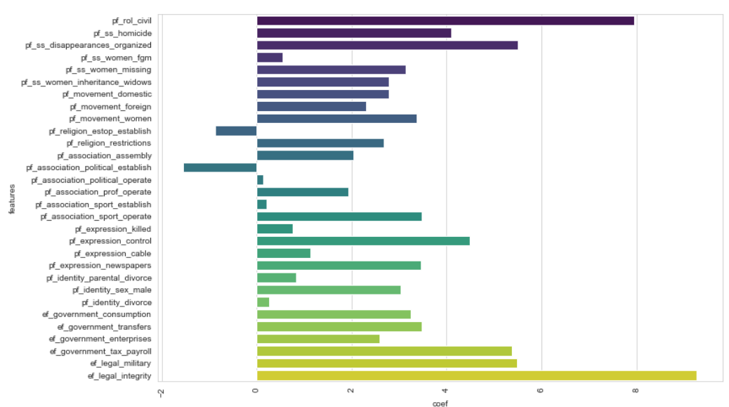
PERFORMANCE OF MODEL
Dropped insignificant features from highest order of iterations | R2 | Adj.R2 | RMSE Test | RMSE Train | Error
Base Model (72 features) | 0.981 | 0.979 | 0.165 | 0.135 | 3%
1st iteration (ef_regulation_labor_bargain) | 0.981 | 0.979 | 0.165 | 0.135 | 3%
2nd iteration (pf_ss_disapperances_injuries) | 0.981 | 0.979 | 0.164 | 0.135 | 2.9%
3rd iteration (ef_regualation_credit_interest) | 0.981 | 0.979 | 0.164 | 0.135 | 2.9%
Final iteration (dropping remaining 23 insignificant columns) | 0.980 | 0.979 | 0.167 | 0.137 | 2.9%
Final Model (Top 30 significant features) | 0.982 | 0.981 | 0.272 | 0.293 | 2%
INFERENCE
Fig.(xii) The top 30 significant features for the final model
Fig.(xii)

Slide 10
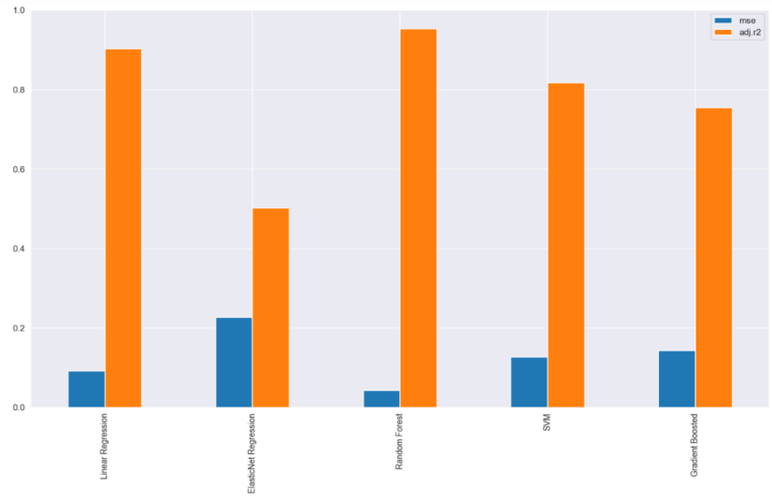
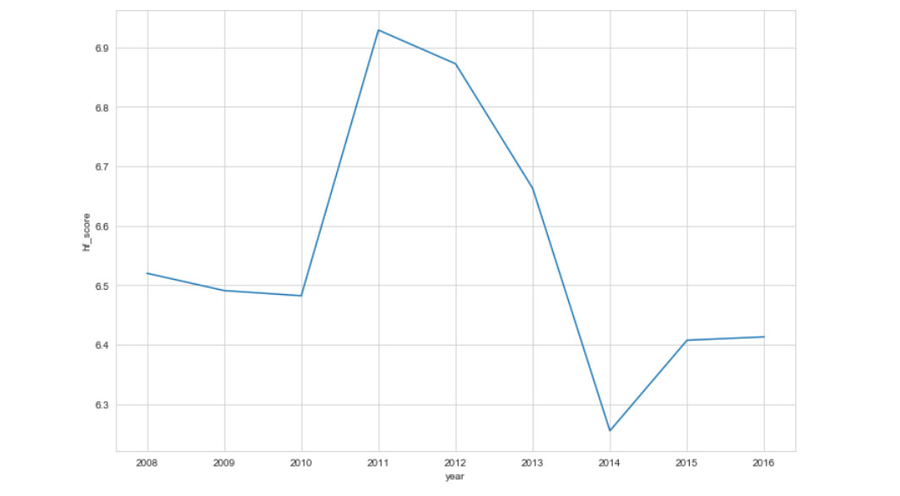
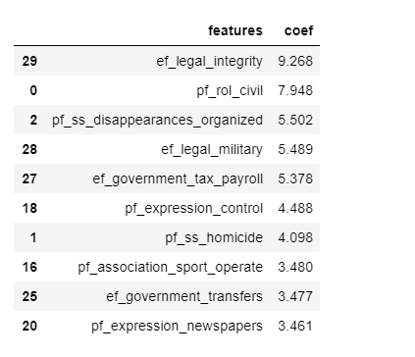
INFERENCE
Fig.(xiv)
Fig.(xiii)
Fig.(xiii) Mean Square Error and Adjusted R-square values for different regression models
Fig.(xiv) Line plot for India for hf_score between 2008 - 2016
The top 30 significant features are the most important features in which the countries should focus on improving the hf_score.
w.r.t. India
are the top significant features present in the model which are contributing less for India where the average scores of top two significant features are 4.26 and 5 respectively which are comparatively very low than other countries scores.
So, India’s should focus on these attributes to improve its position for upcoming years.
Fig.(xv) Decreasing order of significant features
Fig.(xv)

Slide 11
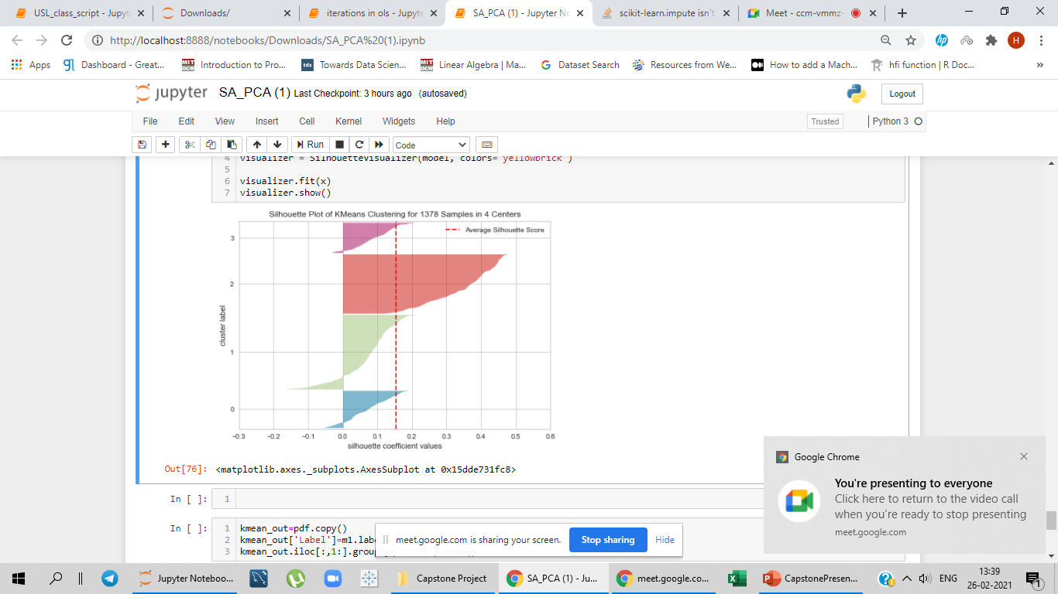
REFERENCES
FUTURE SCOPE
Fig.(xvi) Silhouette Score for k-means clustering for n cluster = 4
Fig.(xvi)
By using four different labels obtained from silhouette score, the data can be further explained using Linear Discriminant Analysis, Multiclass models.
Different models can be built with respect to each country.
Rather than capping which is apt for OLS, the model can be built using Generalized linear model, Linear discriminant analysis with no outlier capping
https://www.cato.org/sites/cato.org/files/2020-12/human-freedom-index-2020.pdf
https://www.kaggle.com/gsutters/the-human-freedom-index/code
https://en.wikipedia.org/wiki/List_of_freedom_indices
https://dsekharulz.wixsite.com/group3

Slide 12
Thanks!

